Slide 1
SE 2023 LAB Activities
Alexandru-Mihail Craciun

Slide 2
Organizational aspects
7 laboratories
Seminar and lab activities - 40%​ from the final mark
Work in teams of 3 people
Progress will be checked at each laboratory
It is recommended to use a Trello-type tool for the efficient management of all tasks.
We want to work according to Agile and Scrum methodologies
Book: “Object-Oriented Software Engineering Using UML, Patterns, and Java” - Bernd Bruegge & Allen H. Dutoit

Slide 3

Statement of the problem
DestinationBucketList – is an app that allows people to create a personal private vacation destinations bucket list.
A vacation destination is a place with a geolocation, title, image, description, stay dates; There is a public list of destinations managed by an admin. Bucket list is private, each user should be able to register and add public items or create new ones private. User should be able to manage items, including removal. Desktop app or web app; Propose friendly display of items and ways to manage them; Users can cancel their account (GDPR) or modify it.

Slide 4
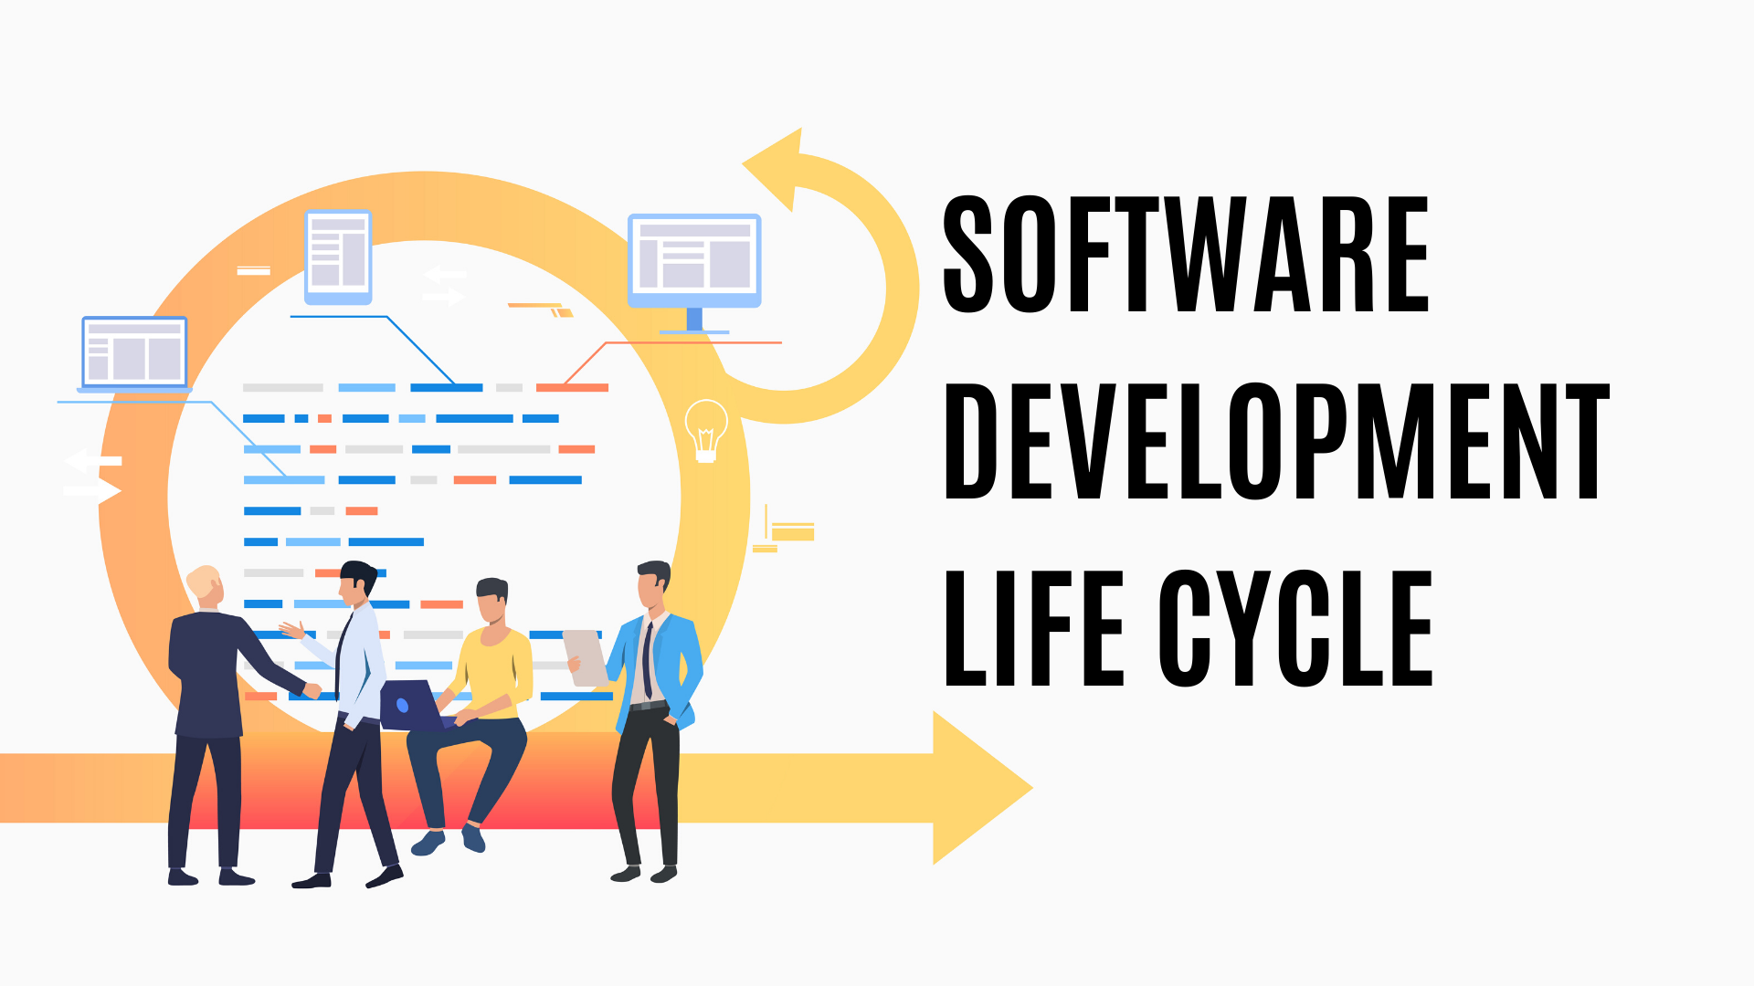

Slide 5
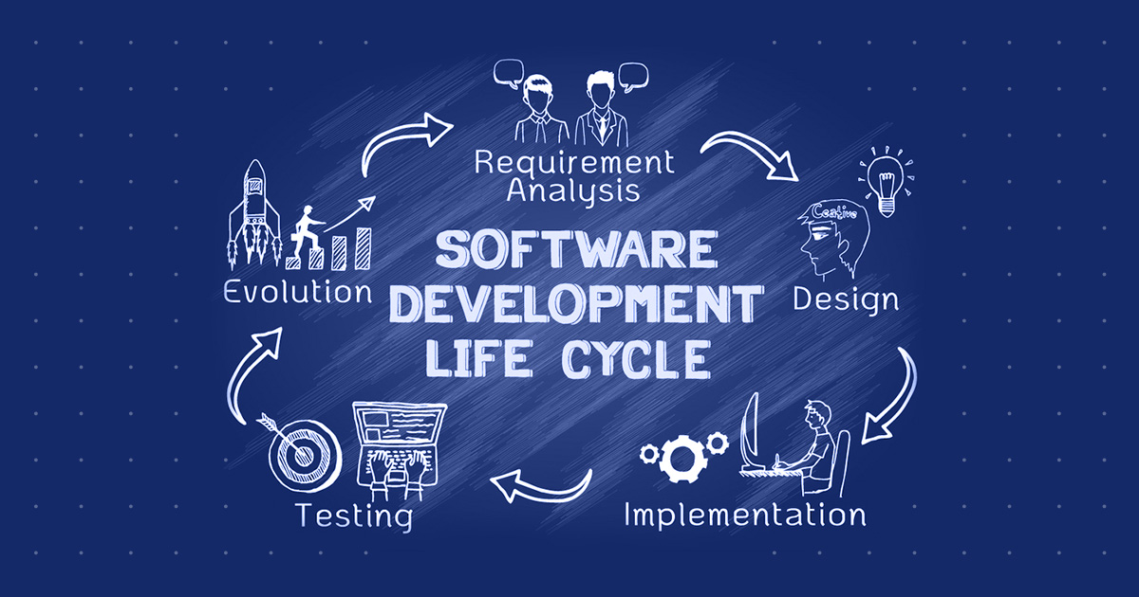

Slide 6
Agile principles
https://agilemanifesto.org/
Our highest priority is to satisfy the customer through early and continuous delivery of valuable software.
Welcome changing requirements, even late in development. Agile processes harness change for the customer's competitive advantage.
Deliver working software frequently, from a couple of weeks to a couple of months, with a preference to the shorter timescale.
Business people and developers must work together daily throughout the project.
Build projects around motivated individuals. Give them the environment and support they need, and trust them to get the job done.
The most efficient and effective method of conveying information to and within a development team is face-to-face conversation.
Working software is the primary measure of progress.
Agile processes promote sustainable development. The sponsors, developers, and users should be able to maintain a constant pace indefinitely.
Continuous attention to technical excellence and good design enhances agility.
Simplicity--the art of maximizing the amount of work not done--is essential.
The best architectures, requirements, and designs emerge from self-organizing teams.
At regular intervals, the team reflects on how to become more effective, then tunes and adjusts its behavior accordingly.
https://agilemanifesto.org/

Slide 7
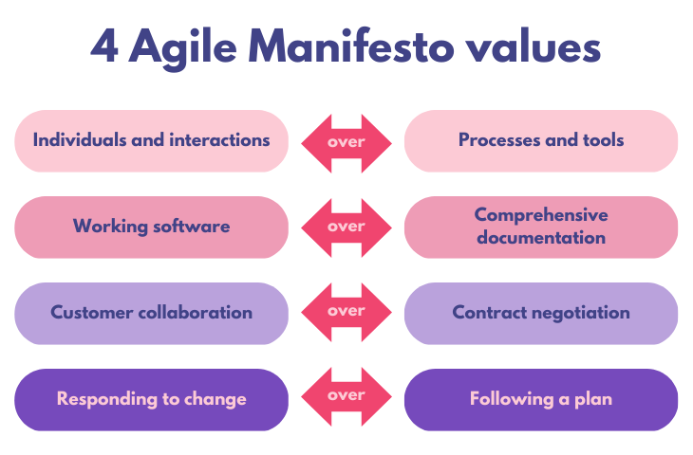

Slide 8
Requirements Elicitation
During requirements elicitation, the client and developers define the purpose of the system.
The result of this activity is a description of the system in terms of actors and use cases.

Slide 9
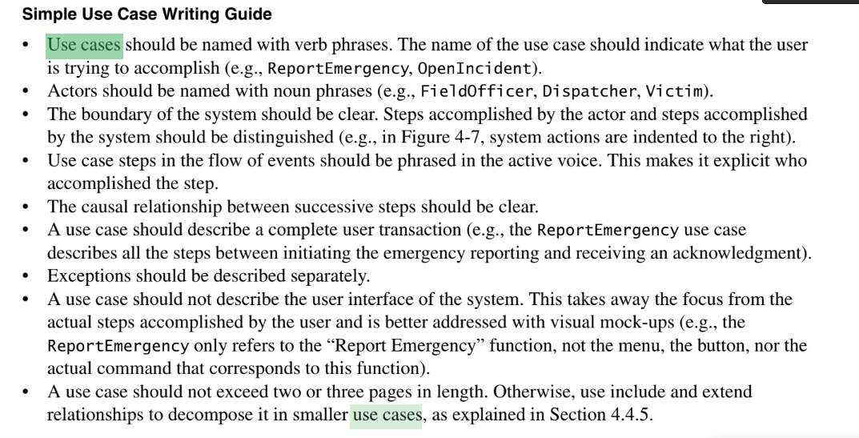
“Object-Oriented Software Engineering Using UML, Patterns, and Java” - Bernd Bruegge & Allen H. Dutoit

Slide 10
Use Case Template
ID and Name
Primary actor |  | Secondary actor
Description
Trigger
Preconditions
Postconditions
Normal flow
Alternative flows
Exceptions

Slide 11
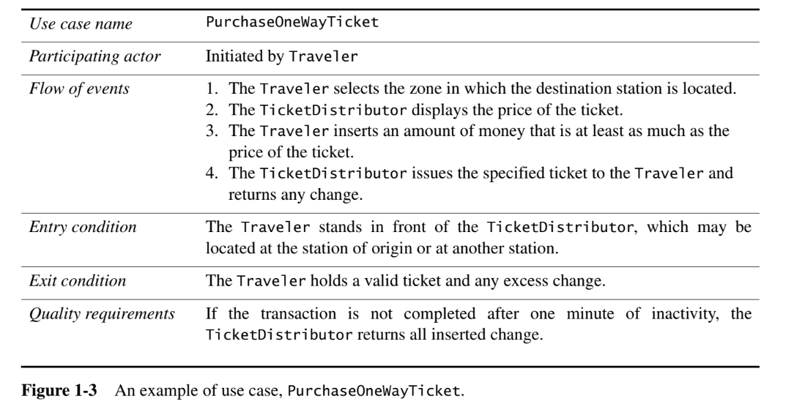
“Object-Oriented Software Engineering Using UML, Patterns, and Java” - Bernd Bruegge & Allen H. Dutoit

Slide 12
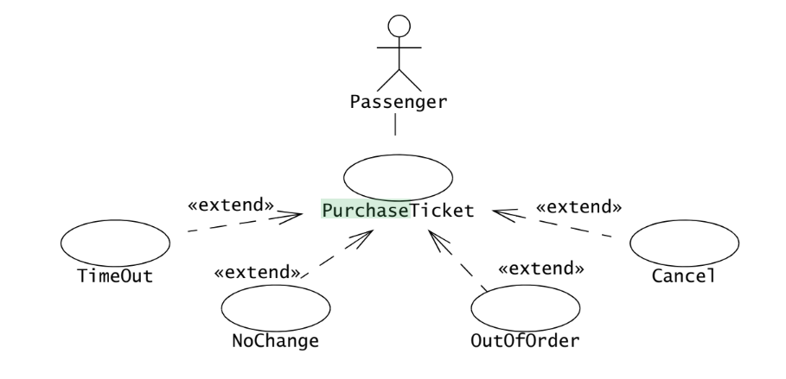
“Object-Oriented Software Engineering Using UML, Patterns, and Java” - Bernd Bruegge & Allen H. Dutoit

Slide 13
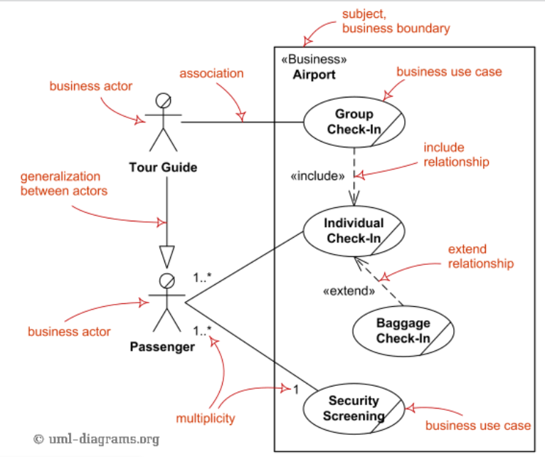
https://www.uml-diagrams.org/use-case-diagrams.html

Slide 14
Tools
VisualParadigm
STAR UML

